Slide 1


Eurasian National University named after L.N. Gumilyov
Faculty of «Information Technologies»
Department of «Information Systems»
To subject computer graphics and pattern recognition
INTEGRATED FACE RECOGNITION AND ANTI-SPOOFING SYSTEM FOR REAL-TIME AUTHENTICATION
IN CASE OF VIRTUAL SYSTEM
Done by: Yerassyl Iskakov
Supervisor: Prof. Zhukabayeva T.K.

Slide 2



INTRODUCTION
Traditional attendance systems whether manual are often time-consuming, prone to errors, and vulnerable to fraud..
1
Face recognition offers a contactless and automated solution, but it is still susceptible to spoofing attacks using photos, videos,.
2
This project introduces a real-time face recognition system integrated with anti-spoofing mechanisms to ensure that only live, genuine users can mark their attendance.
3
By combining deep learning-based face detection with liveness detection techniques, we aim to build a secure, efficient, and accurate system tailored for educational and organizational environment
4

Slide 3

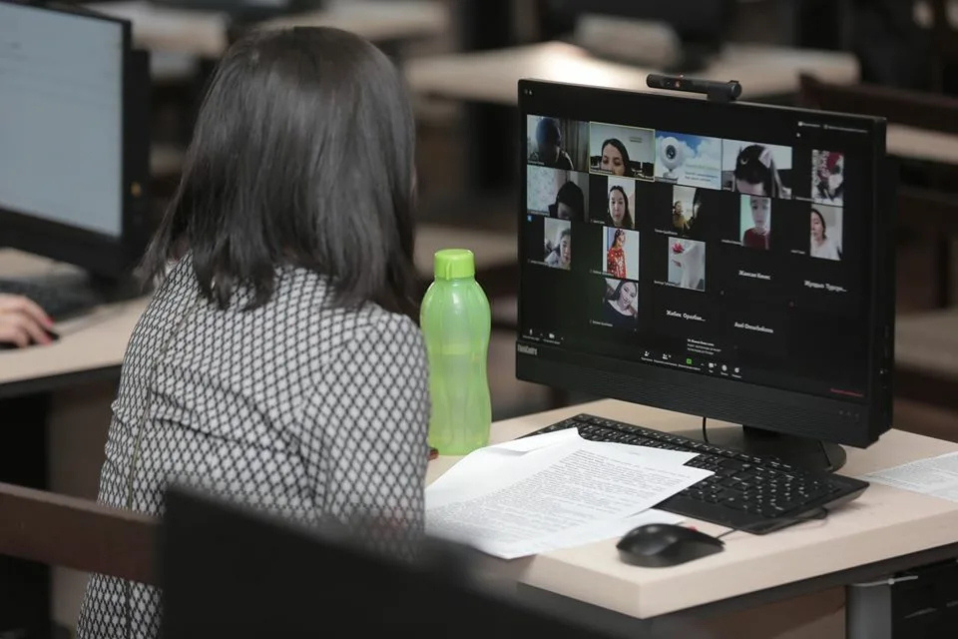
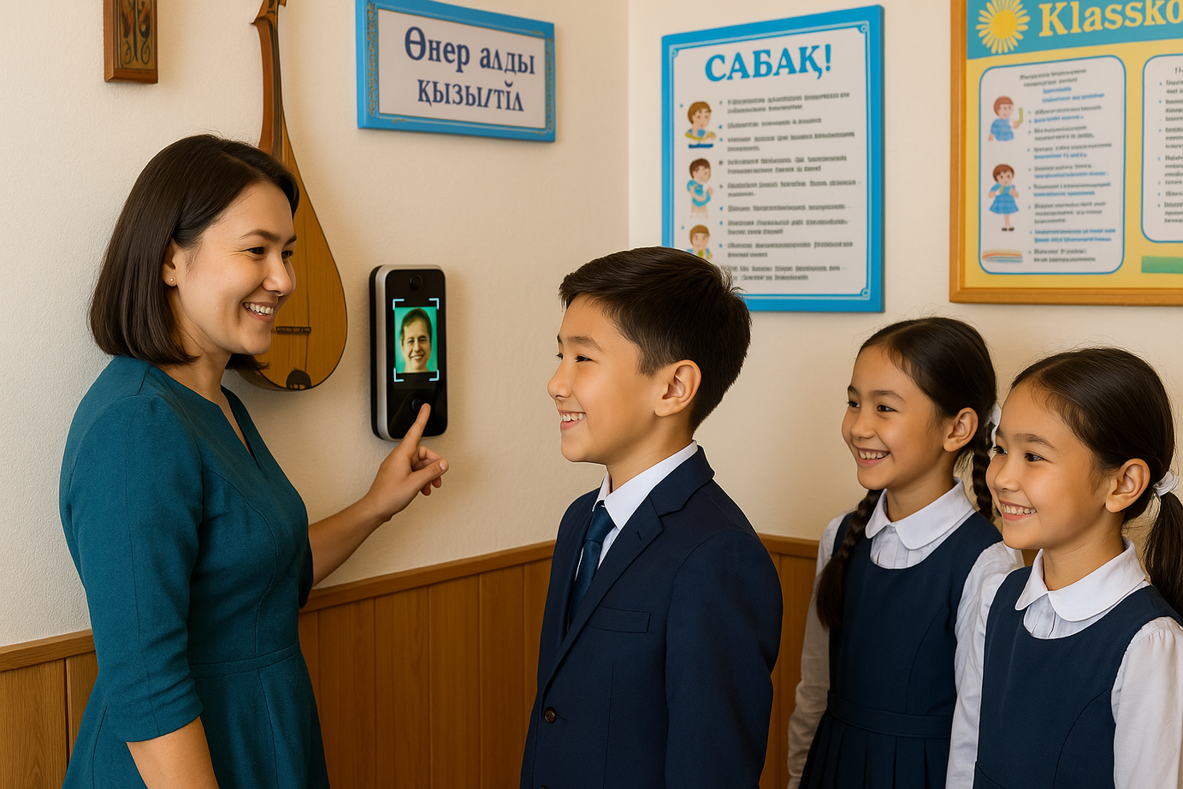




FACE RECOGNITION TECHNOLOGY IN ATTENDANCE SYSTEMS: BENEFITS
Automation. Marks attendance within seconds no manual effort.
Security. Reduces proxy attendance through biometric verification.
Covid-19 case. Hygienic and ideal for post-pandemic settings.
Accurate Records. Eliminates human error in tracking attendance.
Real-Time Monitoring. Instantly reflects attendance status on centralized systems.
Online class application
(teams, zoom, meet)
Traditional class application

Slide 4
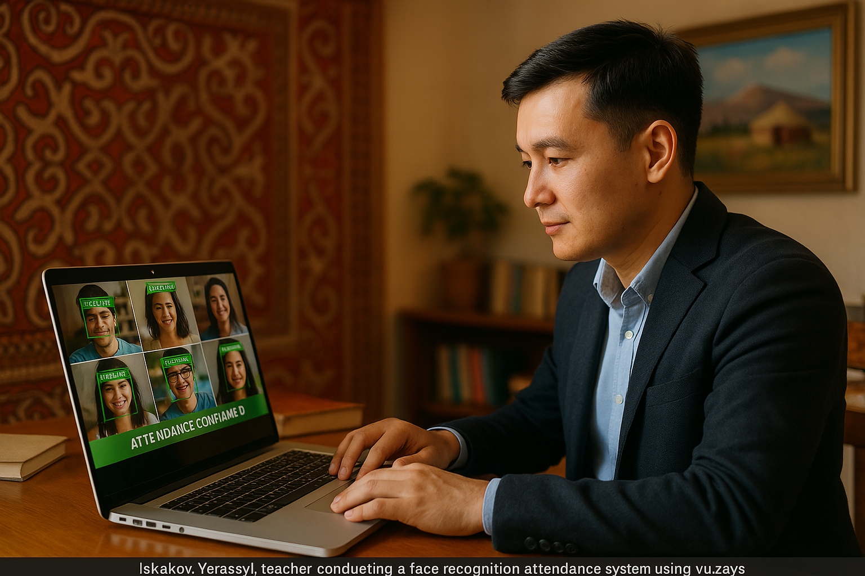
FACE RECOGNITION TECHNOLOGY IN ATTENDANCE SYSTEMS: THEORY
Face Detection
Face Recognition
Anti-Spoofing
Face Embedding
MTCNN (Multi-task Cascaded Convolutional Networks)
MobileNet
SVC (Support Vector Classifier)
Term | Description
Face Detection | Identifying and locating faces in an image or video frame.
Face Recognition | Determining who the detected face belongs to, by comparing to known faces.

Slide 5

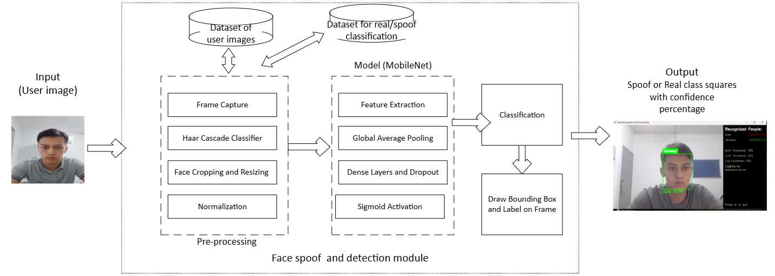
METHODOLOGY
Used MTCNN to detect faces from live camera frames and photos.
Anti-Spoofing Model was built using MobileNet with data augmentation.

Slide 6

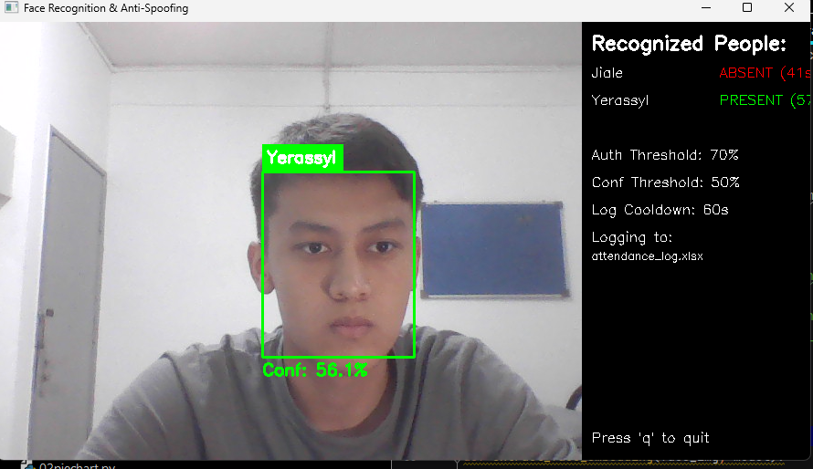

OVERVIEW OF THE SYSTEM DESIGN
Face Recognition
Face Detection
Persantage of each function
Anti-Spoofing Model
UI information desk
Real-Time Recognition

Slide 7

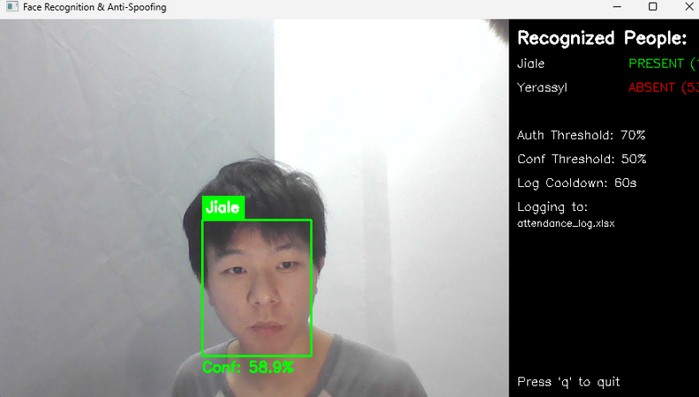
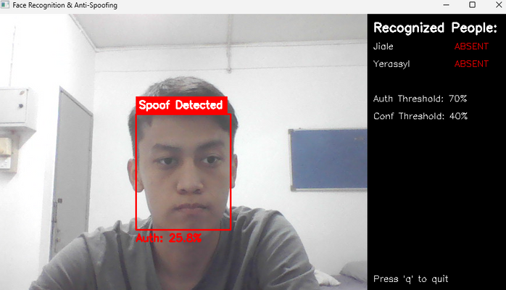
CHALLENGES AND LIMITATIONS
The model is trained on a relatively small dataset
Facial expressions (e.g., smiling, ) reduce cosine similarity accuracy.
Overfitting issue.
Performance drops in poor or inconsistent lighting

Slide 8
CONCLUSION
Ensuring the authenticity of participants is important in the context of online attendance systems in order to prevent identity fraud. This project presents an integrated real-time face recognition and anti-spoofing system designed to enhance authentication accuracy in virtual environments.
The system leverages deep learning techniques to perform both identity verification through face recognition and liveness detection to differentiate between real and spoofed faces.
By combining these capabilities, the proposed solution offers a secure, efficient, and scalable method for real-time attendance verification, significantly reducing the risk of spoofing attacks and unauthorized access.

Slide 9

THANK YOU

